Slide 1
How to command trajectories to multiple AVs
Wushuang Bai

Slide 2

The purpose of this presentation is to show how to command How to command trajectories to multiple AVs. This presentation uses an example of commanding three AVs driving on a irregularly shaped curved road.

Slide 3
Test description is below.
Input:
Commanded trajectories of three vehicles containing x and y in meters
Source data file: curvyRoad_irregularShape_multiVeh_InputTrajectory.csv
Output:
Actual trajectories of three vehicles containing x and y in meters.
Source data file: curvyRoad_irregularShape_multiVeh_OutputTrajectory.csv
Script used:
script_testFcn_fcn_CommandVehTrajectory_MultiVeh.py
fcn_CommandVehTrajectory_ MultiVeh.py
Other data files used:
curvyRoad_irregularShape_multiVeh.sumocfg - this runs the simulation
curvyRoad_irregularShape_multiVeh.net.xml - this describes SUMO road network
curvyRoad_irregularShape_multiVeh.rou.xml - this describes simulation route

Slide 4
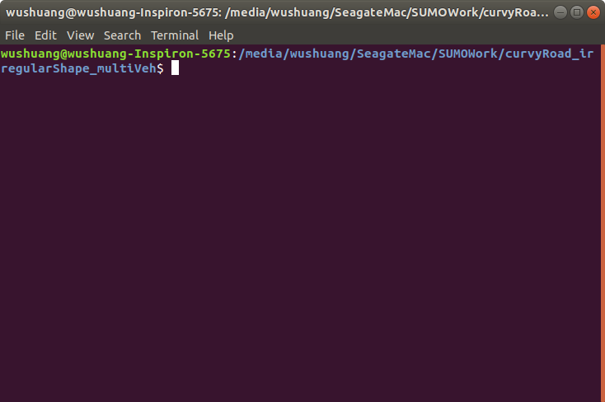
Step 1. Navigate to the folder of data files and script, open a terminal.

Slide 5
Step 2. Run the script by running command "python3 script_testFcn_fcn_CommandVehTrajectory_MultiVeh.py". This script calls the function fcn_CommandVehTrajectory_MultiVeh.py, which calls SUMO using python API, takes user's input of commanded trajectories of three vehicles in x and y, and run the simulation.
#!/usr/bin/python3
# This is a simple example to demonstrate how to command multiple AVs to drive based on input trajectories
# using traci module which allows interfacing SUMO with python.
# Author: Wushuang
# Created on: 2022 07 20
# Revision history:
# 2022 07 25- updated comments
# 2022 07 26- added test script to exercise this function
# For more information, please see https://sumo.dlr.de/docs/TraCI.html#examples
# _____ _
# |_ _| | |
# | | _ __ _ __ _ _| |_ ___
# | | | '_ \| '_ \| | | | __/ __|
# _| |_| | | | |_) | |_| | |_\__ \
# |_____|_| |_| .__/ \__,_|\__|___/
# | |
# |_|
# inputFilePath: this is the csv file you want to use as commanded trajectories. This input should contain at least column vehicle_x and vehicle_y
# format: csv
# timeStep: this is the time step you want to use in the simulation. If this input is not given, it uses the default value 1
# format: string, such as "1"
# outputFilePath: this is the output file path of the simulation.
# format: sumo outputs simulation as xml file. It can be then converted to csv file.
# simConFigFilePath: this is the simulation configuration file that you want to run.
# ____ _ _
# / __ \ | | | |
# | | | |_ _| |_ _ __ _ _| |_ ___
# | | | | | | | __| '_ \| | | | __/ __|
# | |__| | |_| | |_| |_) | |_| | |_\__ \
# \____/ \__,_|\__| .__/ \__,_|\__|___/
# | |
# |_|
# Simulation_Flag: this flag confirms that the simulation runs succesfully.
# format: int

Slide 6
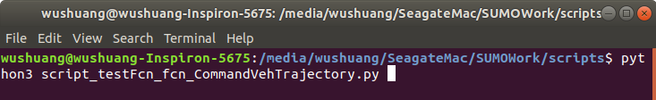
Step 2. Run the script by running command "python3 script_testFcn_fcn_CommandVehTrajectory_MultiVeh.py". This script calls the function fcn_CommandVehTrajectory_MultiVeh.py, which calls SUMO using python API, takes user's input of commanded trajectories of three vehicles in x and y, and run the simulation.
Note that in this example, the inputs given to the script are:
InputFilePath = " ./curvyRoad_irregularShape_multiVeh_InputTrajectory.csv "
OutputFilePath = "/curvyRoad_irregularShape_multiVeh_OutputTrajectory.csv"
SimConfigFilePath = “./curvyRoad_irregularShape_multiVeh.sumocfg “

Slide 7
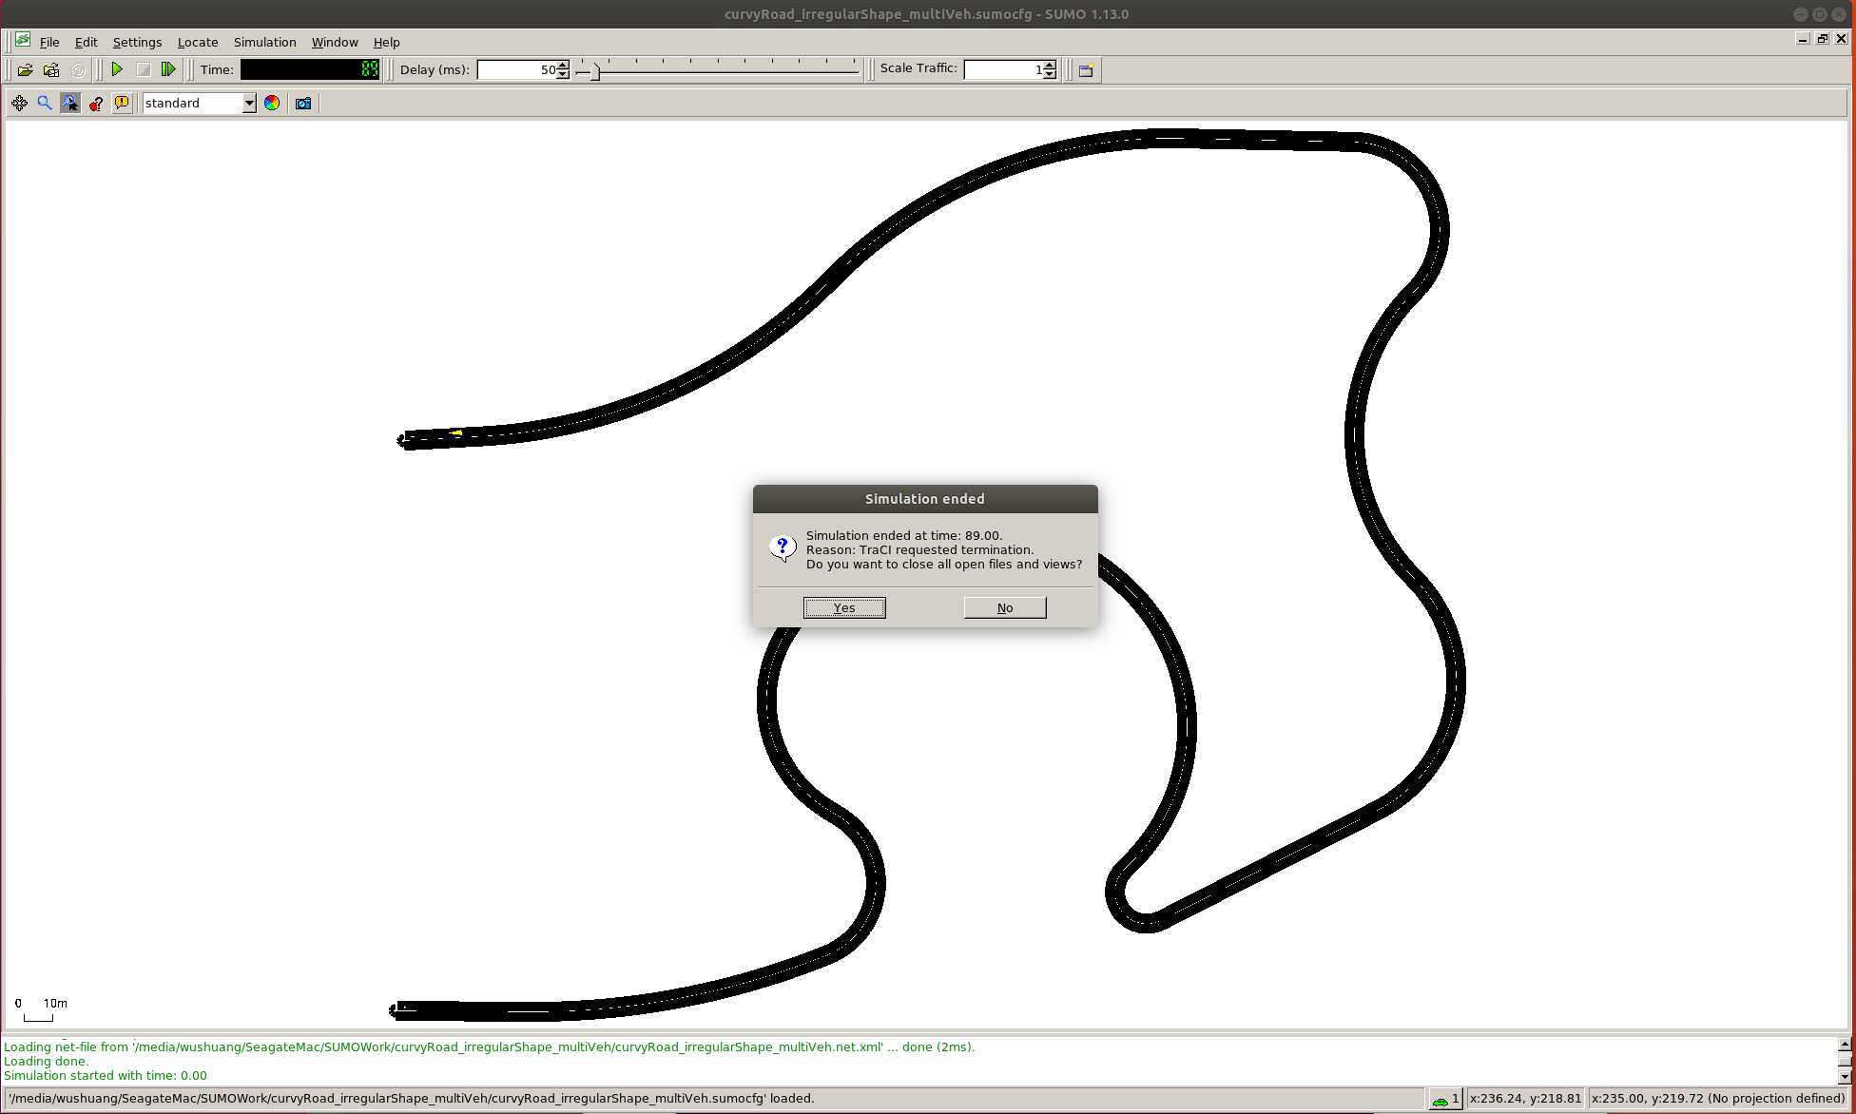
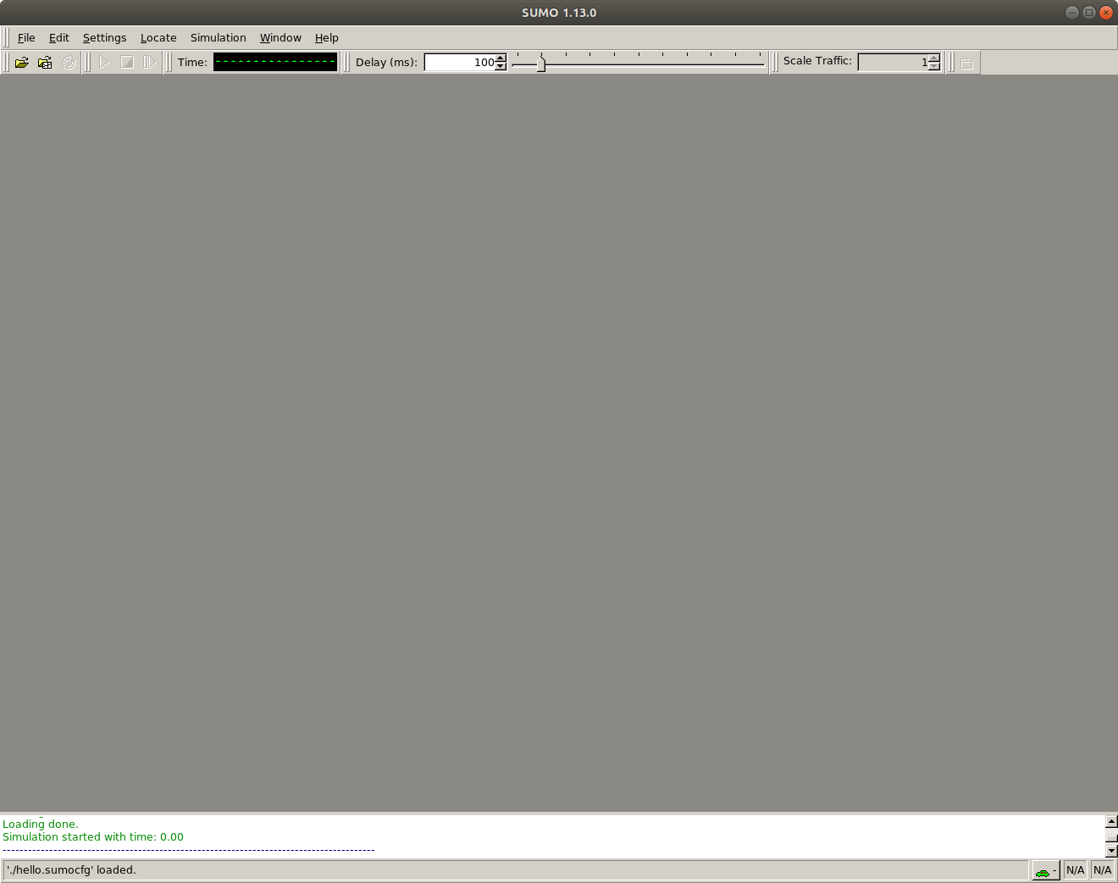
Step 3. Once simulation ends, close SUMO to end the script. Please note that you have to close SUMO to end the script so that output file can be written.

Slide 8
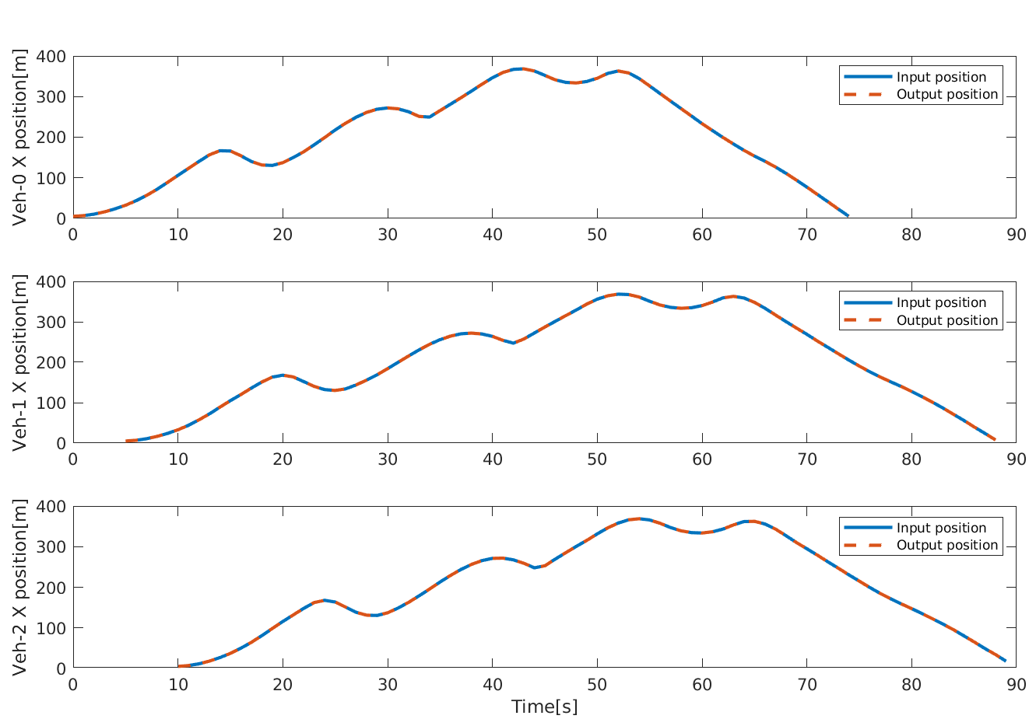
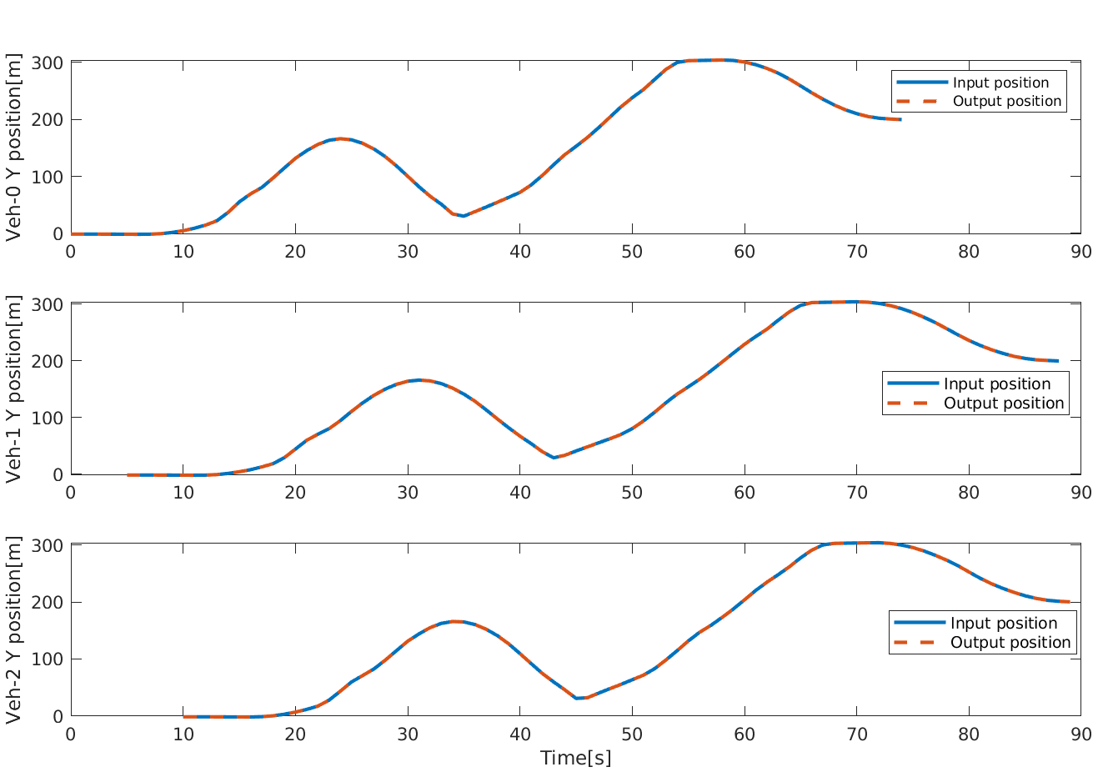
Step 4. Investigating the results. In this example, input trajectory is a complex irregular-shaped curved line. The results show that the actual output trajectories of three vehicles match the input ones. Please note that the output file is in xml format. For how to convert it from xml to csv, please see the document "How to export SUMO simulation results.pptx"
Input and output X position of three vehicles
Input and output Y position of three vehicles

Slide 9
Files used in this document can be found:
Data files can be found: https://github.com/ivsg-psu/TrafficSimulators_GettingStartedWithDifferrentSimulators_GettingStartedWithSUMO/tree/main/Data/
Script can be found: https://github.com/ivsg-psu/TrafficSimulators_GettingStartedWithDifferrentSimulators_GettingStartedWithSUMO/tree/main/Code
For more information, please see:
https://sumo.dlr.de/docs/TraCI.html
https://sumo.dlr.de/docs/TraCI/Change_Vehicle_State.html

